Slide 1
MLB Analysis: How to win it All!?
Andrey Tokarev
Karla Murphy
Jared Graeve
Simon Feinsilver

Slide 2
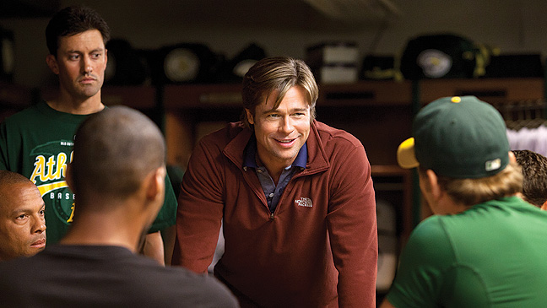
MoneyBall: Part 2…

Slide 3
Minus Brad Pitt ☹

Slide 4
Objectives
Compare the Total Salary Spent between the World Series Winners and “Losers”
Do the teams that spend the most, win the most?
Evaluate guiding parameters for salary spent for the World Series Winners
Are there statistical commonalities between World Series Winners

Slide 5
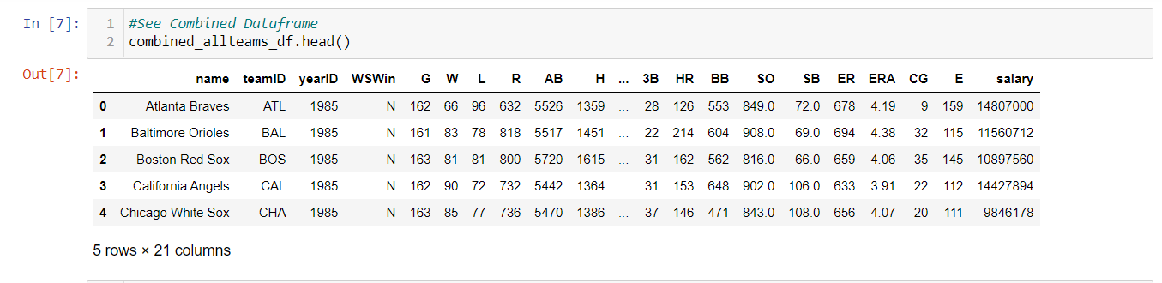
But first: Data Collection
Baseball has a history of statistical analysis
Kaggle has a great baseball databank full of csv files
Able to read in those csv files, merge, and go to work!
Limited scope of analysis to more modern era (1985-2015)

Slide 6
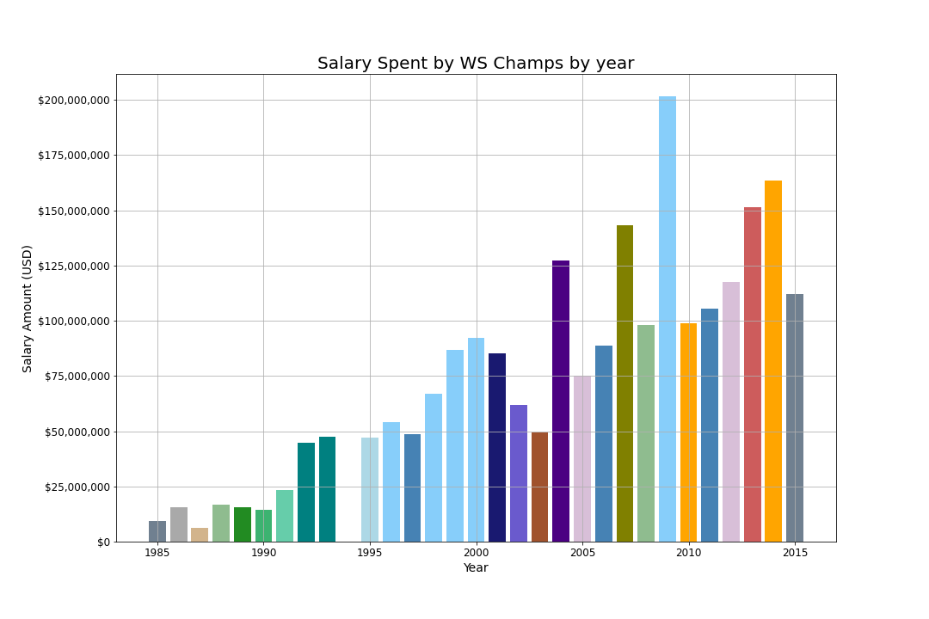
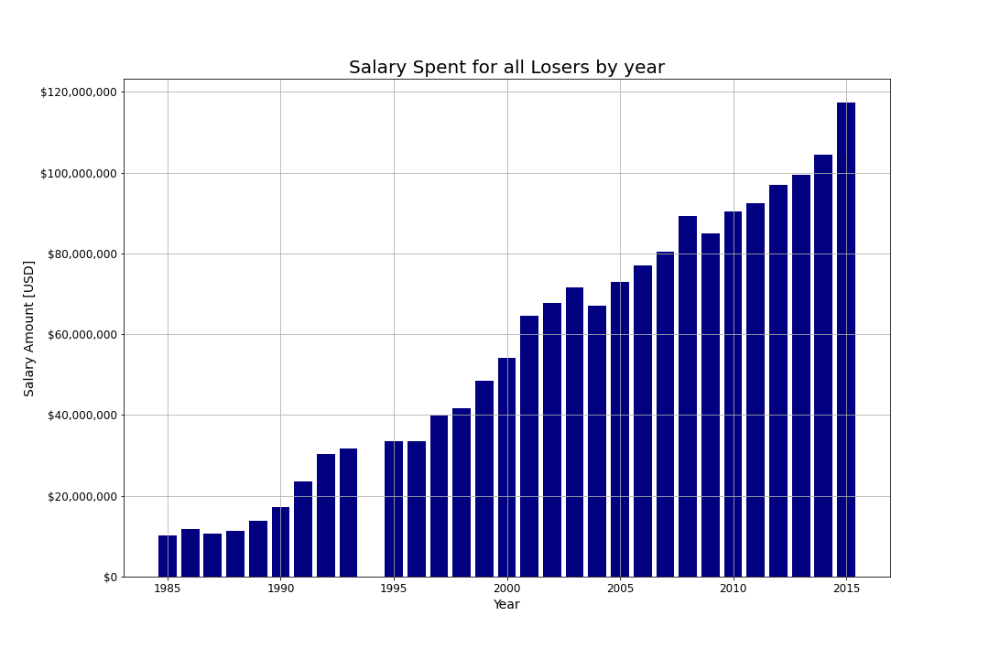
Objective 1: Compare Salaries between winners and Losers

Slide 7
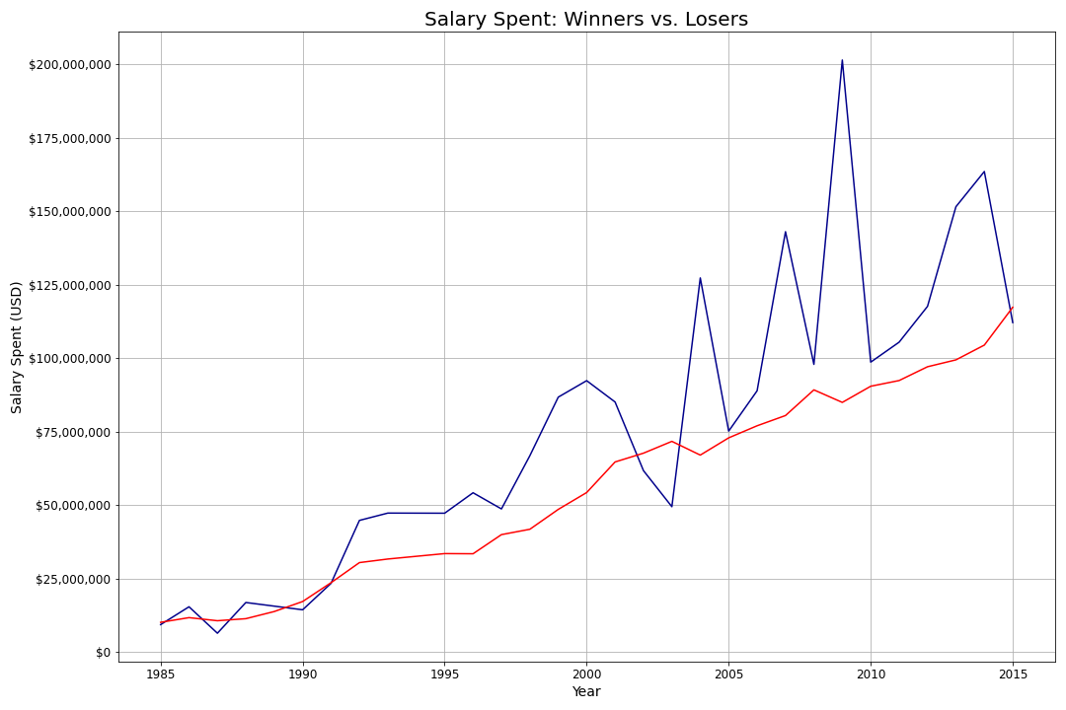
Summary Graph of Winners vs. Losers

Slide 8
Objective 1: conclusions
What we CAN conclude:
What we CAN’T conclude:
Some time around 1990 spending became a formidable weapon in the pursuit of a championship
By and large, teams that win the championship are spending more then teams that don’t win the championship
We can’t definitively say that you HAVE to spend more than the league average to win a championship
Can’t definitively say that spending more money will GUARANTEE a championship

Slide 9
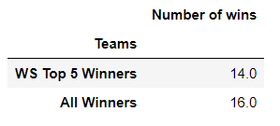
Objective 2: Do teams that spend the most, win the most?
Analyze further the effect of spending on winning championships
How often do teams that are top 5 spenders in the league for that year win the championship
30 teams in MLB, how often do the top 5 teams (16.67%) win the championship?

Slide 10
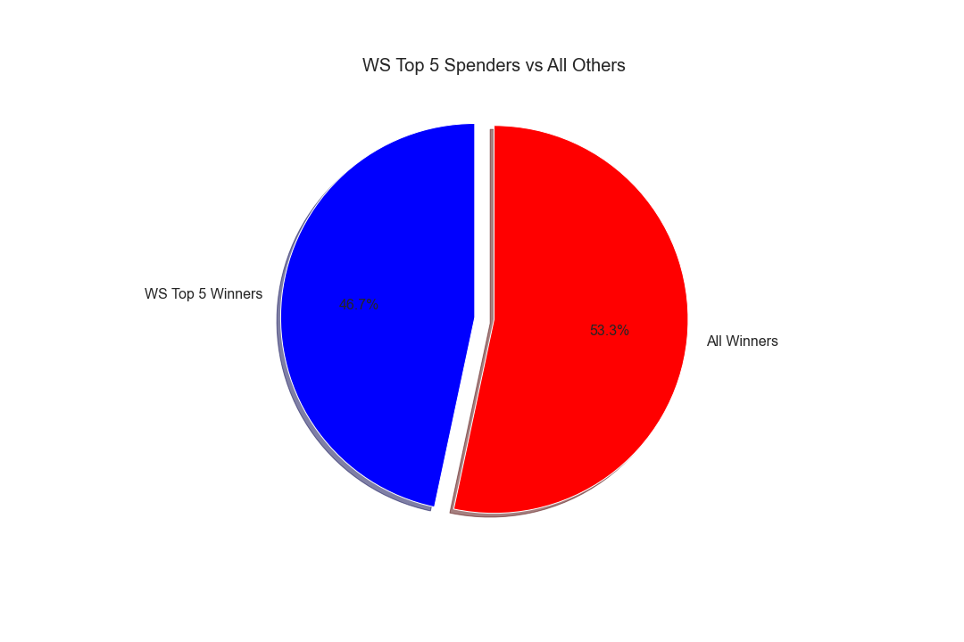

Slide 11
Objective 2: conclusions
What we CAN conclude:
What we CAN’T conclude:
If an owner is willing to be a top 5 spender, they have about a 50% chance of winning the World Series
Cannot conclude that you have to be a top 5 spender to win
Over half of the winners from 1985-2015 were not top 5 spenders

Slide 12
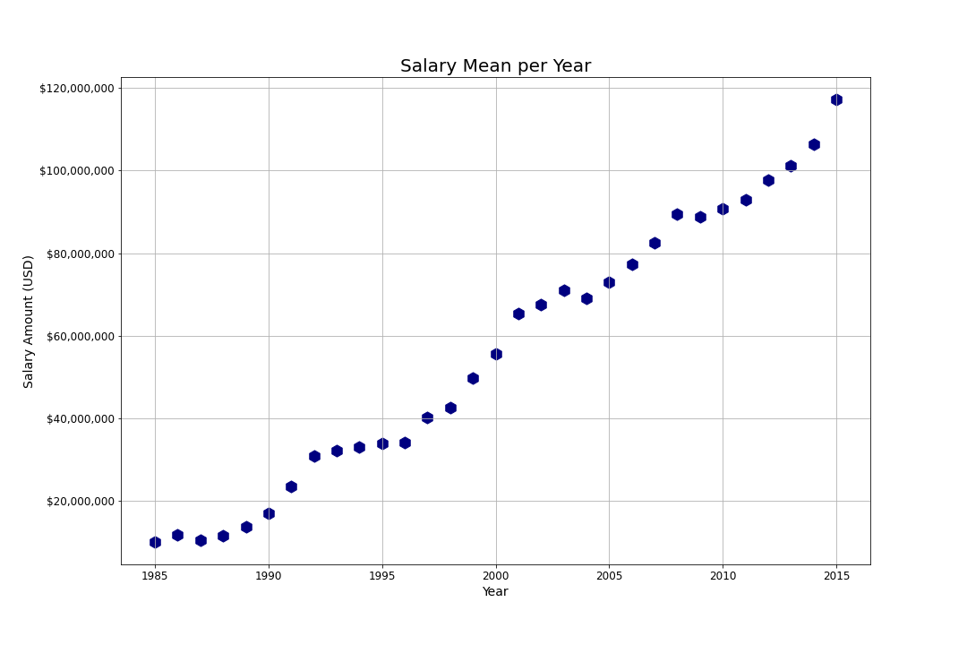
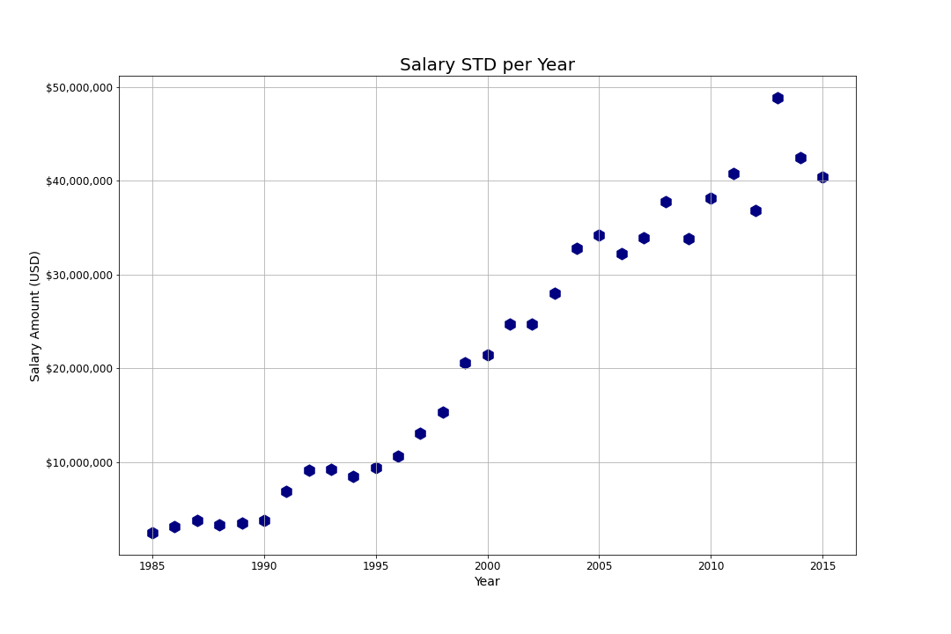
Objective 3: Evaluate spending parameters for World series winners

Slide 13
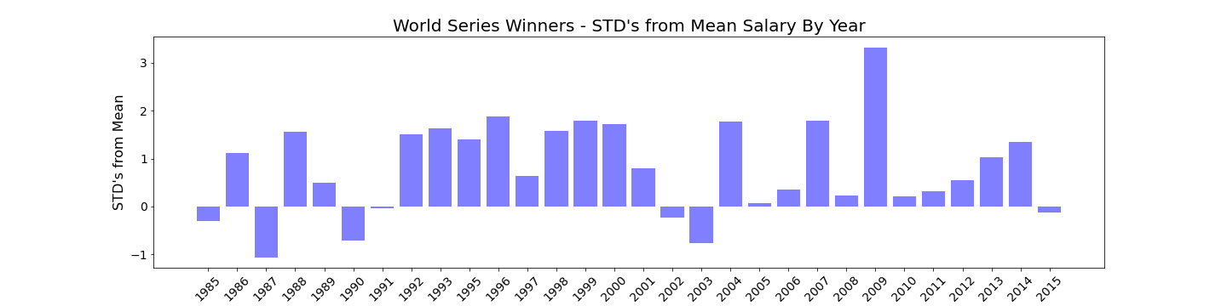
Winner STD’s from Mean

Slide 14
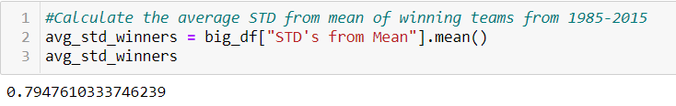
Winner AVG STD’s from Mean
On average, winners spent .79 STD’s above the mean for that year
THE SPENDING FORMULA:
Spend Amount($) = Mean Salary + (STD * .79)
Example:
2021 Expected Mean Salary: $150MM
2021 Expected STD: $40MM
$150MM + ($40MM * .79)
We would recommend the owner spend $181,600,000 if serious about winning!!!

Slide 15
Objective 3: conclusions
What we CAN conclude:
What we CAN’T conclude:
Winning teams spend, on average, .79 STD’s above the mean salary
Spending Formula
Can’t conclude that spending .79 STD’s above the mean will guarantee a championship
Spending Formula Problems:
How to project Salary Mean and STD in coming years

Slide 16
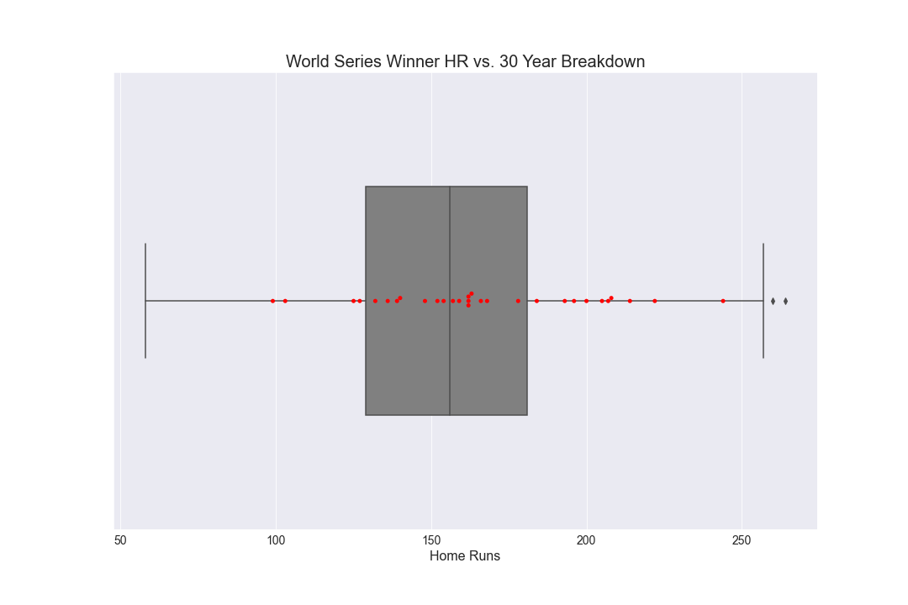
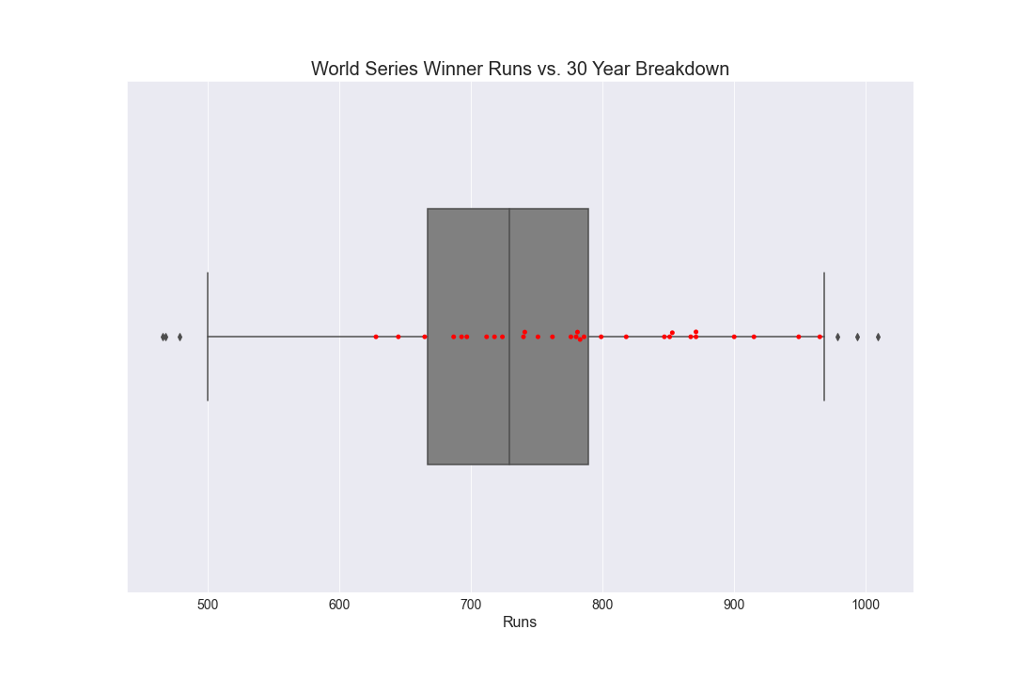
Objective 4: Statistical commonalities between Winners
Offense

Slide 17
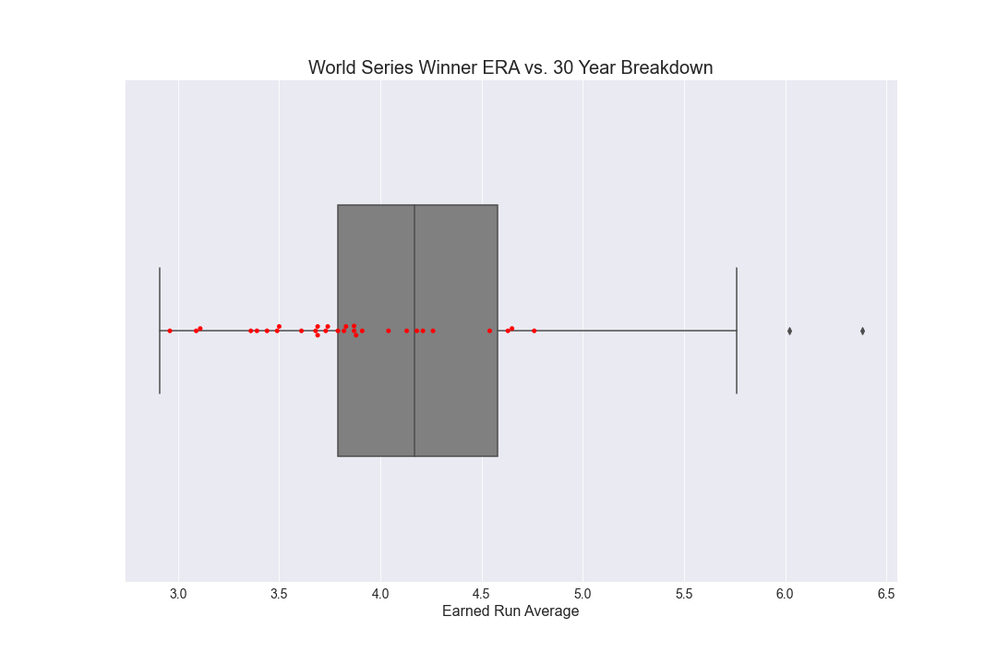
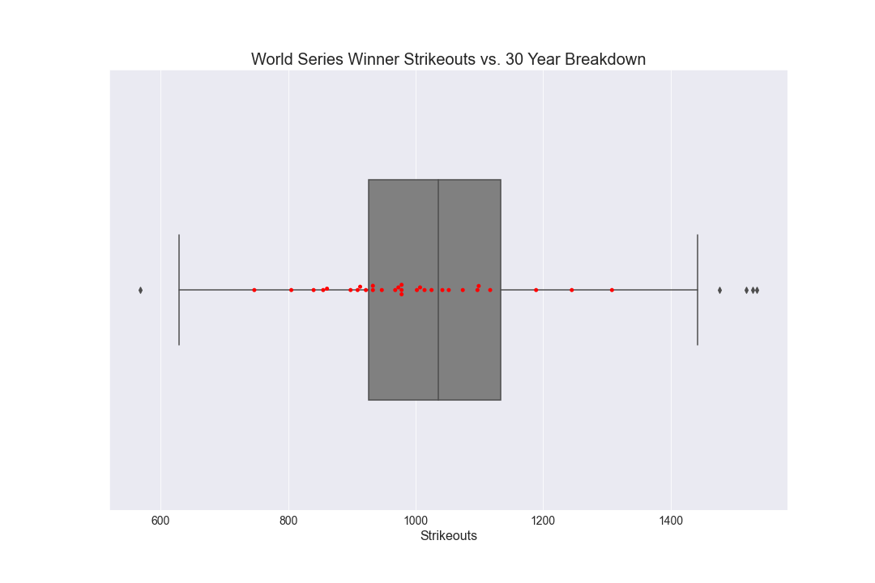
Objective 4: Statistical commonalities between Winners
Defense

Slide 18
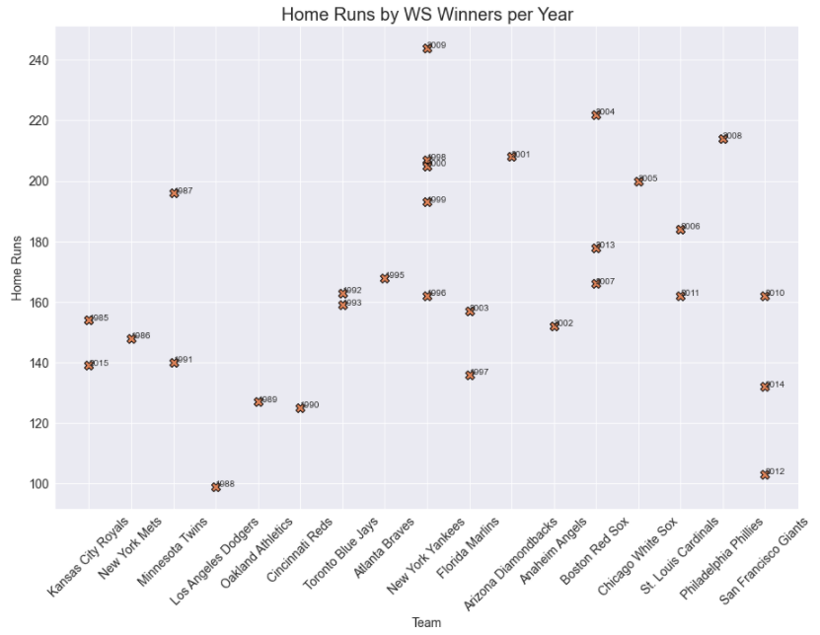
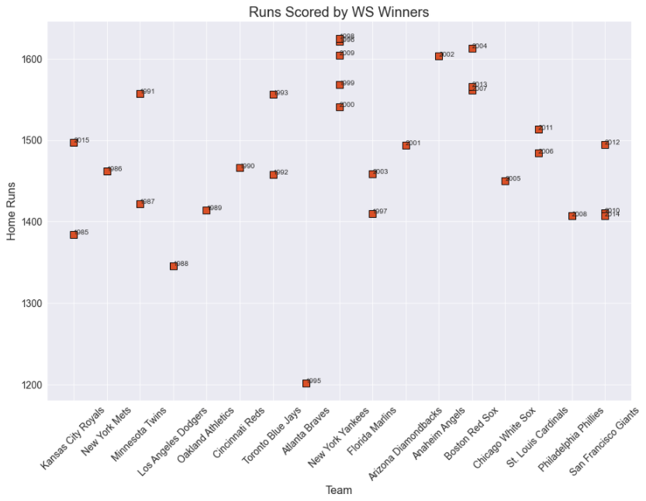
Objective 4: Statistical commonalities between Winners
Offense

Slide 19
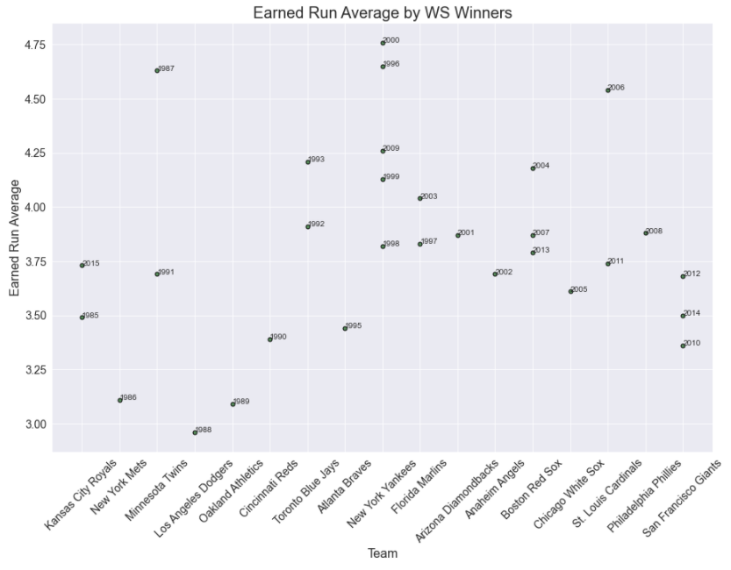
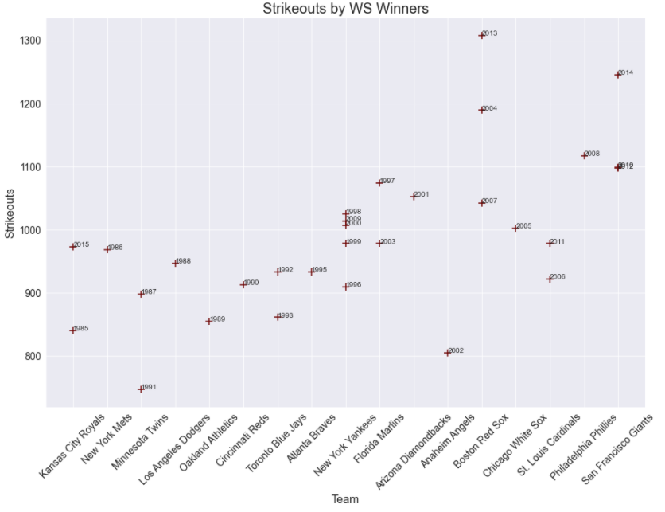
Objective 4: Statistical commonalities between Winners
Defense

Slide 20
Objective 4: conclusions
What we CAN conclude:
What we CAN’T conclude:
Jared review and add conclusions
Jared review and add conclusions

